Slide 1
Auto-tagging online content
for
content market efficiency
Ankit Singh(2018MSBDA003)
Arkaprabha Majumdar(2018MSBDA015)
Divya Kumari(2018MSBDA020)

Slide 2
Content
Need for Auto-tagging of online content
Data Collection
Data Preprocessing
Data Preparation
Topic extraction using Latent Dirichlet Allocation(LDA)
Algorithm Selection and Implementation
Results
Reference

Slide 3
Objective of the presentation:Why auto-tagging online content?
For content marketers and decision makers
Unstructured large Data scattered across platforms
Manually tagging online content is problematic
For proper content marketing management

Slide 4
workflow
DATA PARSING
DATA PREPROCESSING
KEYWORDS GENERATION
LDA (To assign labels)
CLASSIFICATION

Slide 5
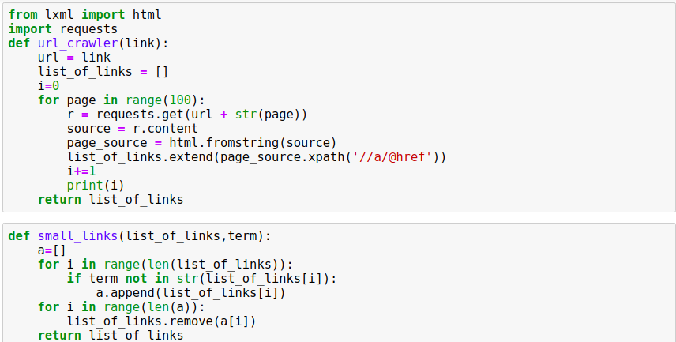
Data Collection - URL parsing

Slide 6
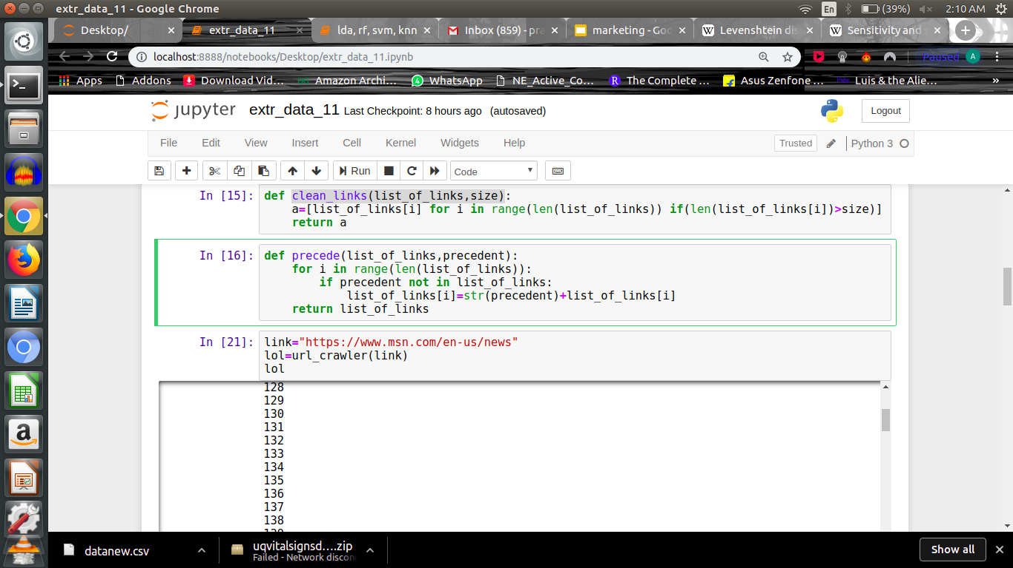
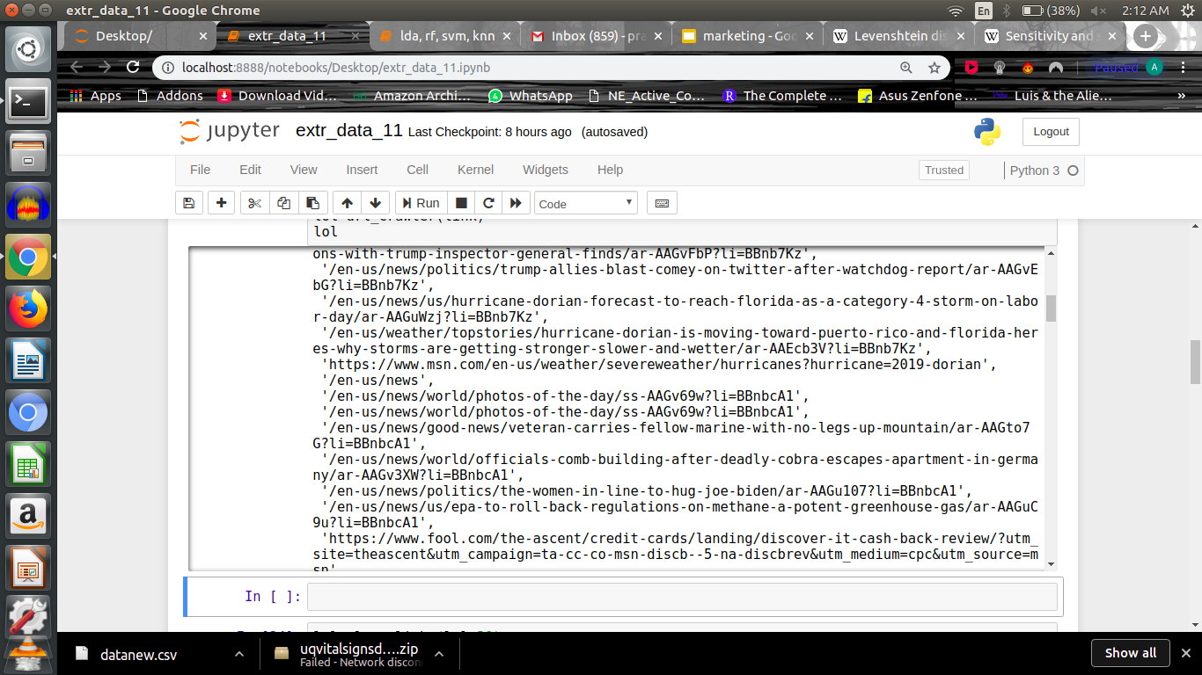

Slide 7
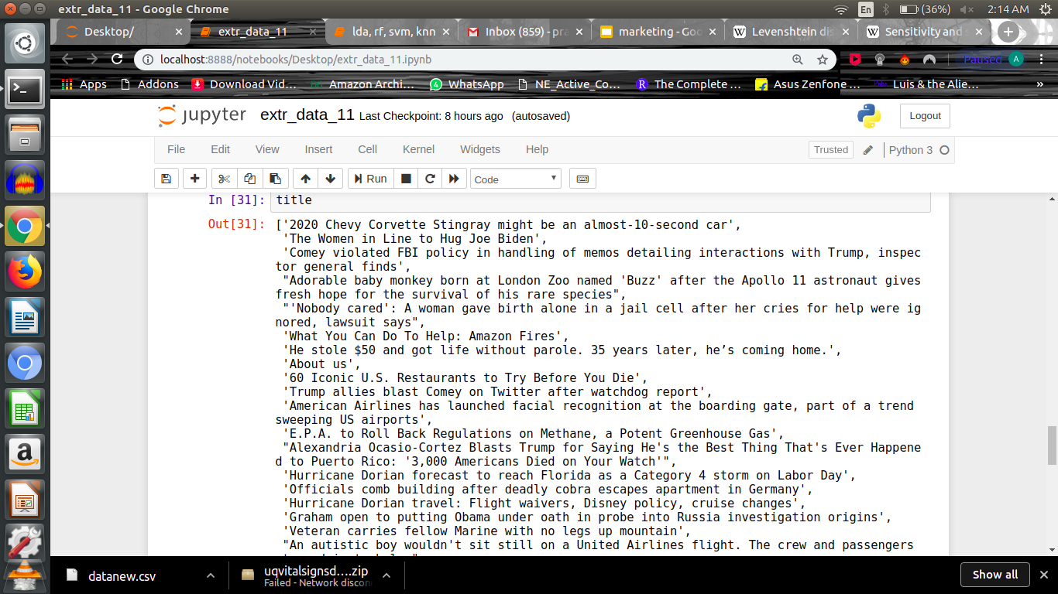
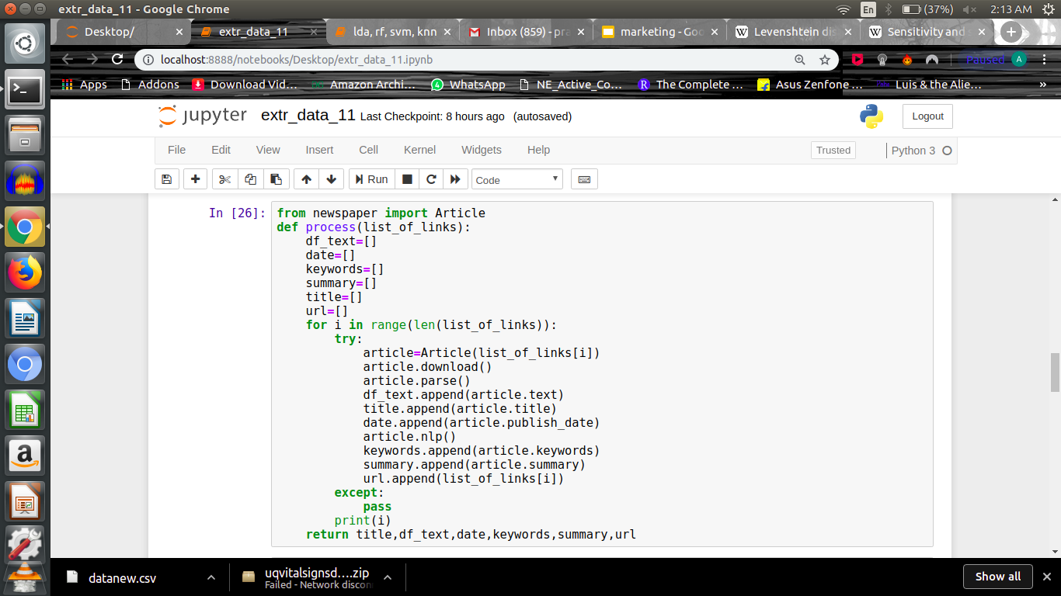
title,text,date,keywords,summary,url=process(list(set(lol)))
data=pd.DataFrame({"description":title,"text":text,"date":date,"keywords":keywords,"summary":summary,"url":url})

Slide 8
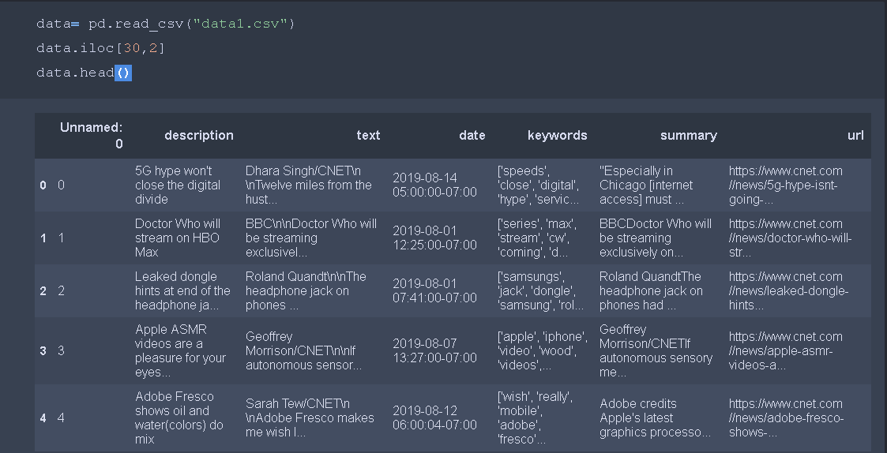
Dataset
The resulting dataset contains information about the article’s Content, its Title, the Date it was made and its Keywords.

Slide 9
Keyword Extraction from Articles using NLP
In research & news articles, keywords form an important component since they provide a concise representation of the article’s content
Keywords also help to categorize the article into the relevant subject or discipline.
Conventional approaches of extracting keywords involve manual assignment of keywords based on the article content and the authors’ judgment.
This involves a lot of time & effort and also may not be accurate in terms of selecting the appropriate keywords.
With the emergence of Natural Language Processing (NLP), keyword extraction has evolved into being effective as well as efficient.

Slide 10
WORK FLOW
Text Pre-processing
- Noise Removal
-Normalization
Data Exploration
- Word Cloud to Understand Frequently Used Words
- Top 20 single Words , bigram
Convert Text to a Vector of Word Count
Convert Text to a vector of Term Frequency
Sort Terms in Descending Order Based on Term Frequencies to identify TOP 10 KEYWORDS

Slide 11
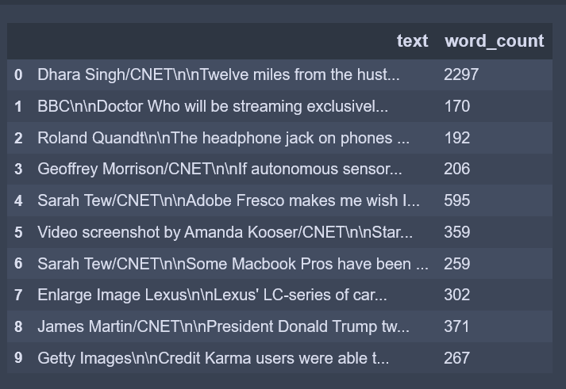
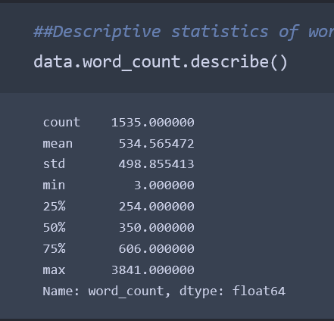
Preliminary text exploration
Before we proceed with any text pre-processing, we quickly explore the dataset in terms of :
word counts

Slide 12
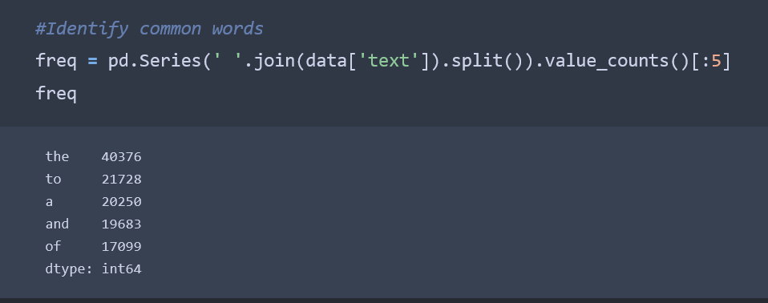
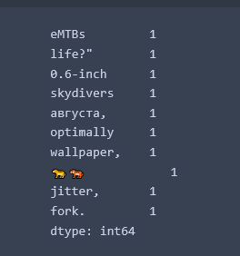
most common words.
most uncommon
words

Slide 13
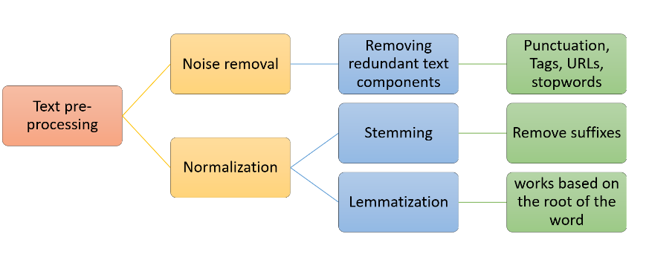
PRE-PROCESSING

Slide 14
NOISE Removal
When a news article is extracted from the web, it contains some information that is not useful for the classification task, such as
Java Script functions, file routes, and source tags. Hence, a data cleaning procedure is needed to filter out such noise.
first we eliminate the “SOURCE:” tag present in a large number of articles,
followed by the initial tags such as “NEWS /”.
We then eliminated certain patterns that occurred with blank text (e.g. “';// ]]]]”).
Subsequently, we remove all JavaScript objects and functions, by eliminating all text between brackets.
Finally, we filtered out unnecessary characters such as: extra white space, non-alphabetic characters, stop-words, or words that have no actual meaning in the text (e.g.and,the,or).

Slide 15
Normalization
Handling multiple occurrences / representations of the same word is called normalization.
word learn — learn, learned, learning, learner.
normalised version — “learn”.
Stemming - Stemming normalizes text by removing suffixes.
Lemmatization - A more advanced technique which works based on the root of the word.
difference :
stem might not be an actual word whereas, lemma is an actual language word
Eg : INVERSELY
OUTPUT 1=INVERS
OUTPUT: INVERSELY

Slide 16
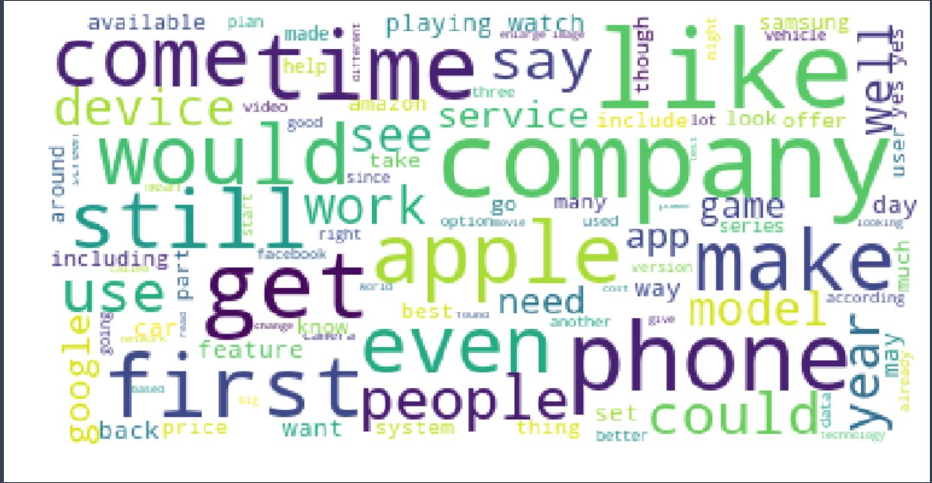
WORD CLOUD
We will now visualize the text corpus that we created after pre-processing to get insights on the most frequently used words

Slide 17
Text preparation
Text in the corpus needs to be converted to a format that can be interpreted by the machine learning algorithms.
There are 2 parts of this conversion —
Tokenisation and Vectorisation
Tokenisation is the process of converting the continuous text into a list of words.
The list of words is then converted to a matrix of integers by the process of vectorisation.

Slide 18
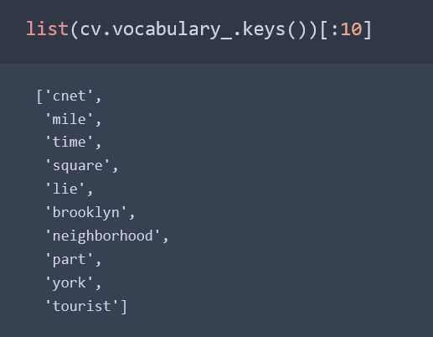
Creating a vector of word counts
As the first step of conversion, we will use the CountVectoriser to tokenise the text and build a vocabulary of known words.
max_freq , max_features, n-gram range

Slide 19
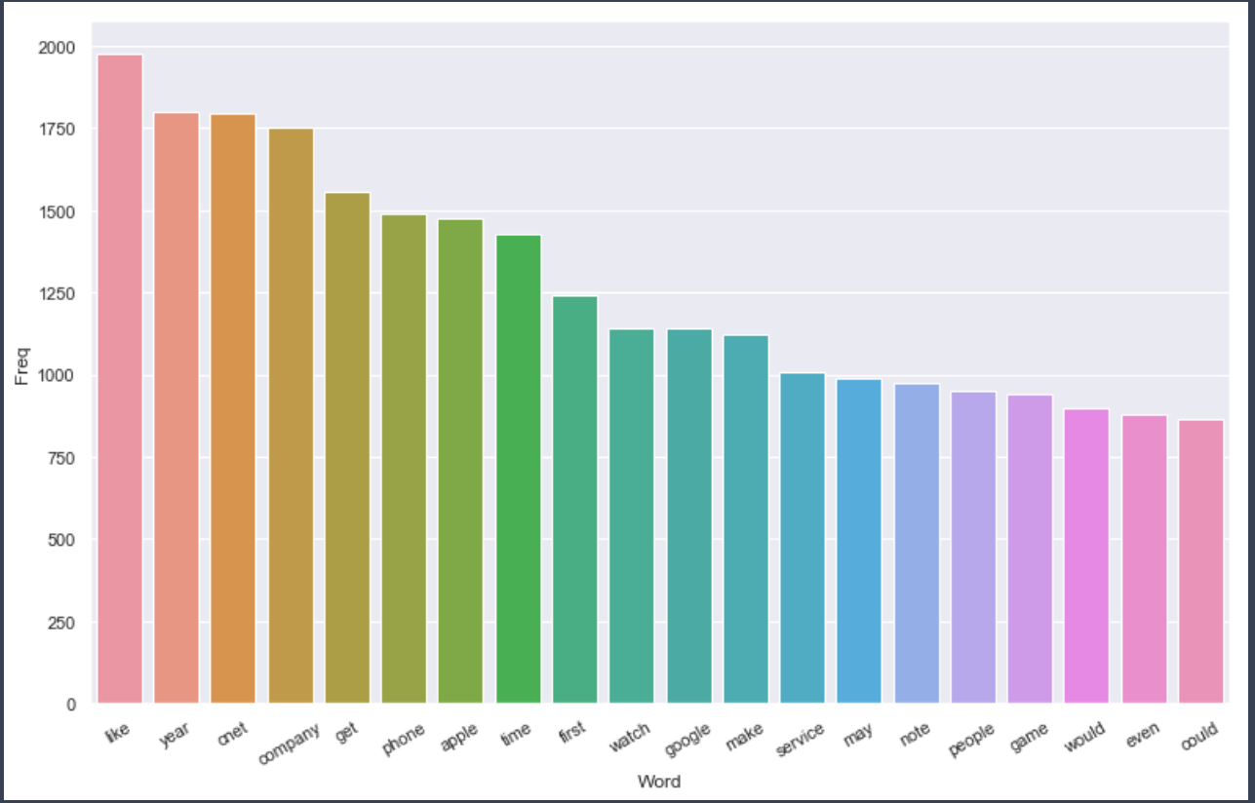
Plot of most frequent words

Slide 20
TFIDF
In our model , the text comprises of the head line and body text of the article content.
Machine learning models only take numbers as input
Hence, to convert our articles from text to numbers, we opted for the TF-IDF method over simply counting the number of appearances of each unique word in each article.
TF-IDF assigns scores to each word, based on how common /uncommon they are in a specific article.
In order to create the TF-IDF matrix, the limits of the percentage of frequency of words need to be assigned first.

Slide 21
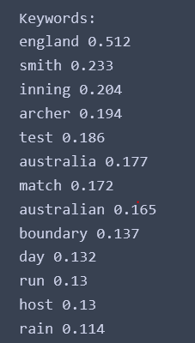
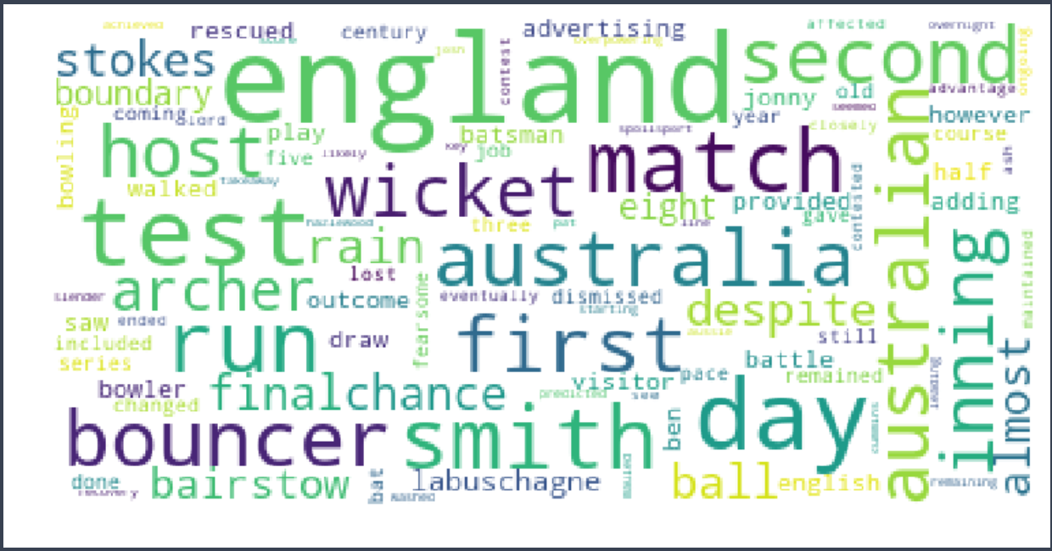
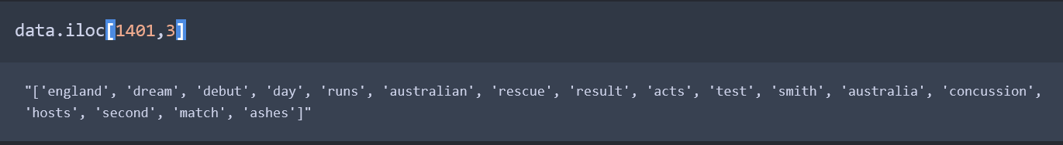
KEYWORDS

Slide 22
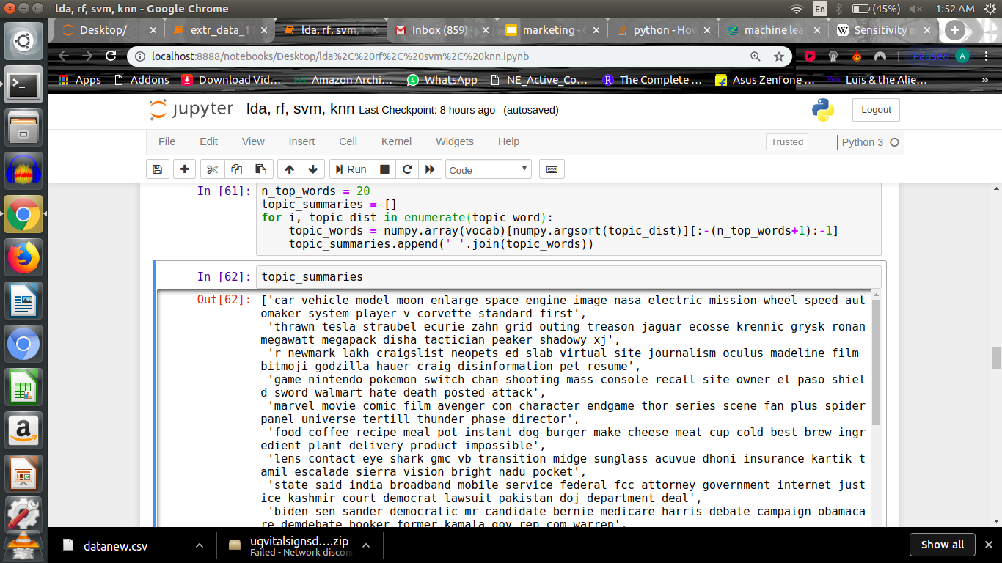
Topic extraction using LDA
To assign labels to the data now we’ll use tf-idf matrix for topic modeling
Using the LDA Algorithm for topic modelling
We found 20 topics which will be used to obtain labels

Slide 23
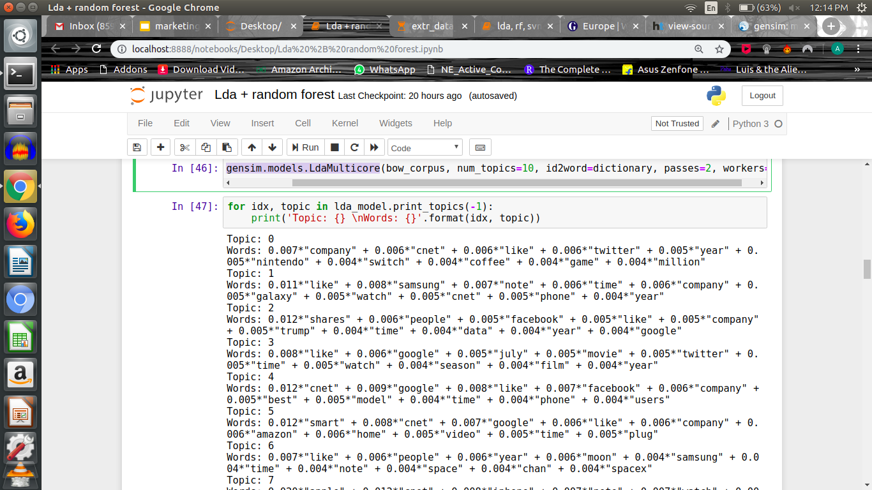
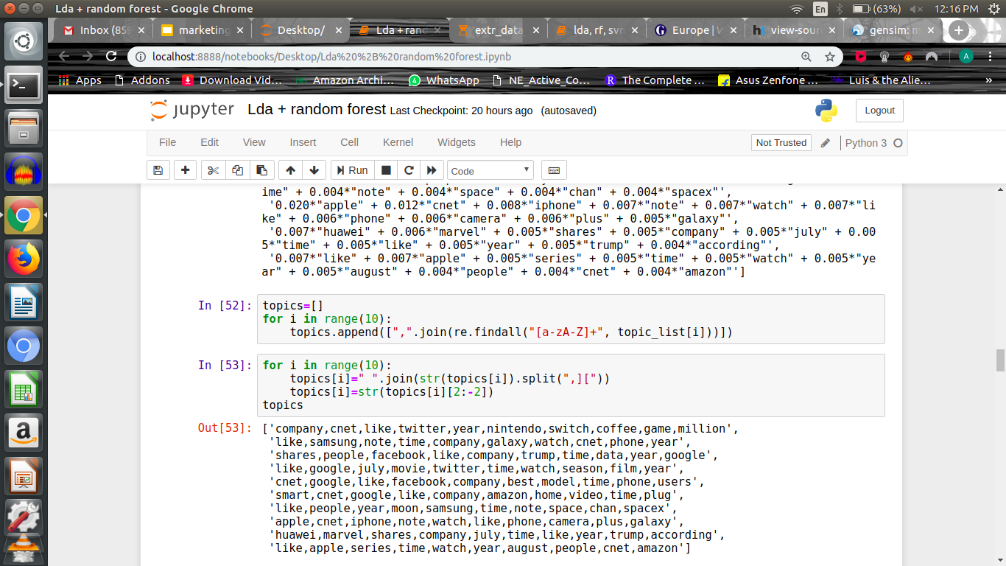
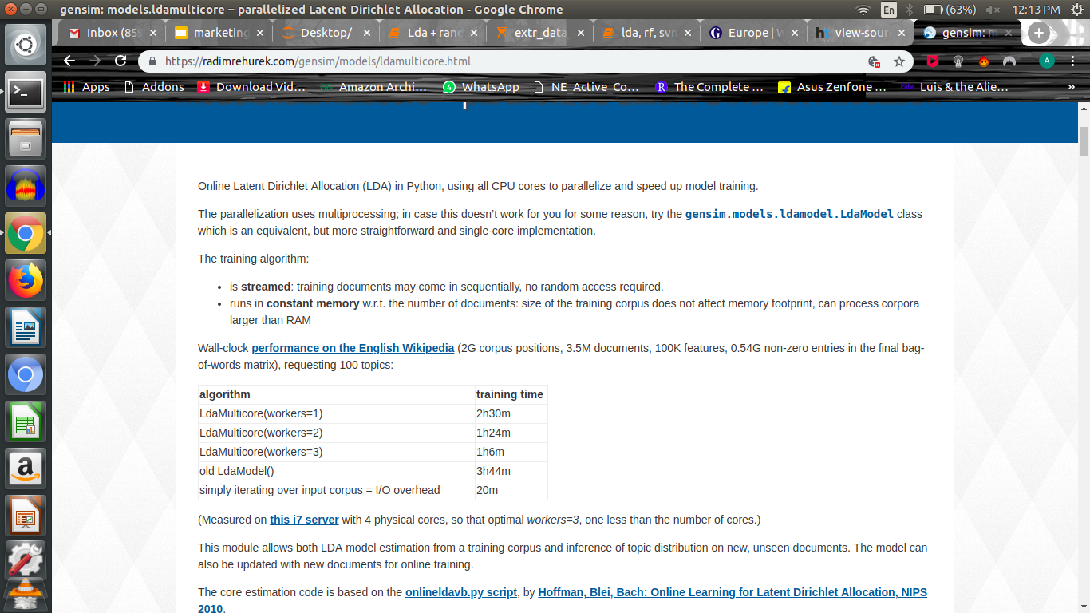
Using Gensim :-

Slide 24
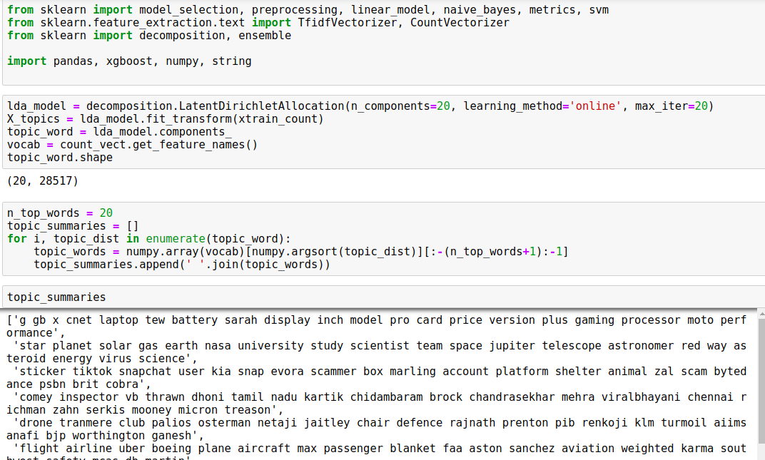
Using SkLearn :-

Slide 25
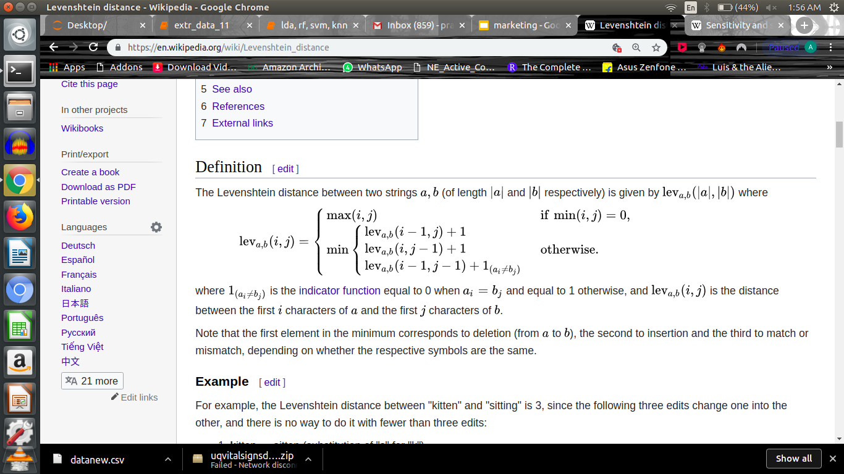
Levenshtein ? A new metric
Deletion
Insertion
Match / Mismatch
Eg:
kitten > sitten (substitution of "s" for "k")
sitten > sittin (substitution of "i" for "e")
sittin > sitting (insertion of "g" at the end).

Slide 26
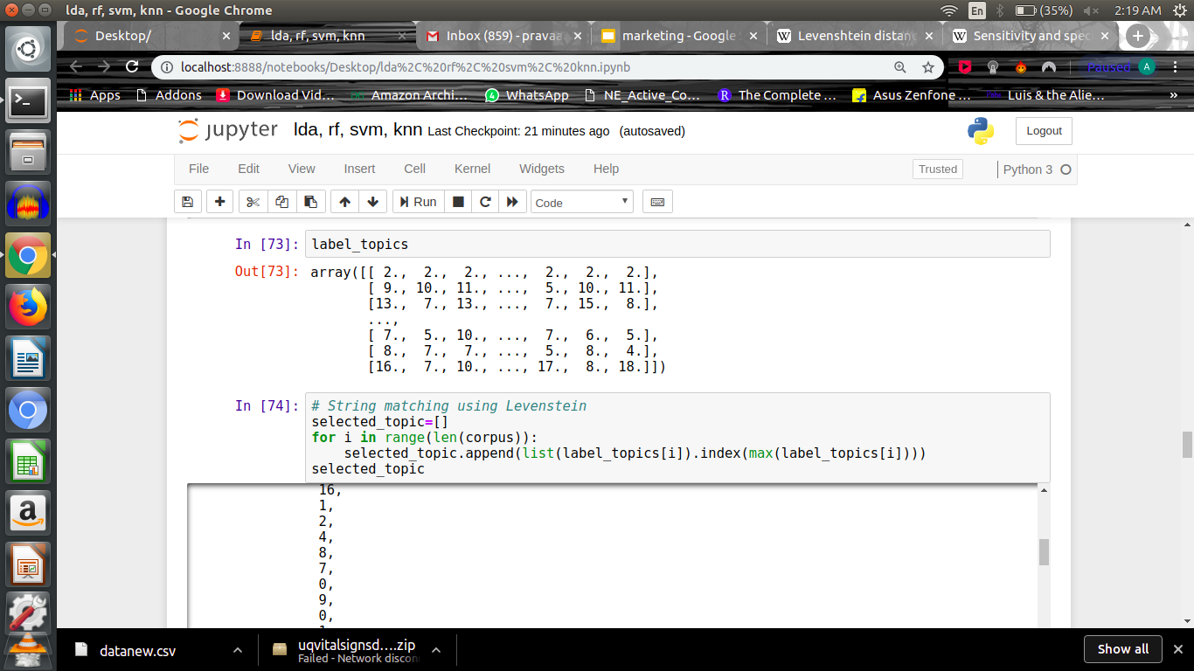
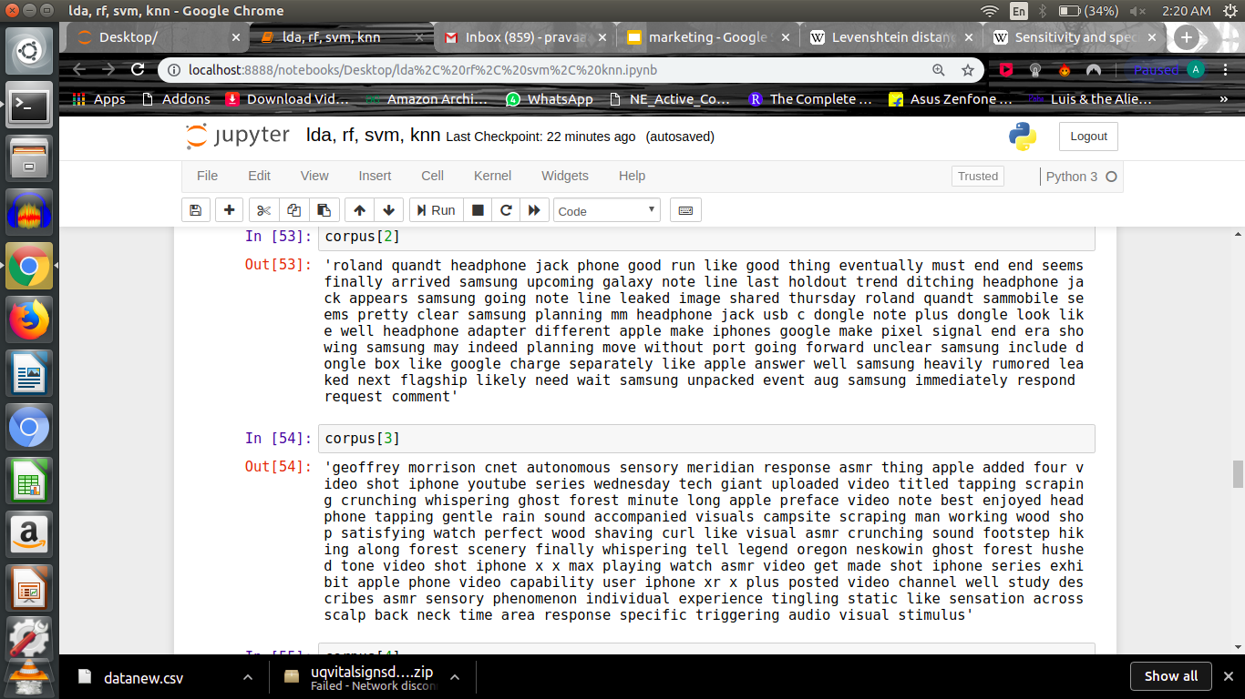

Slide 27
Algorithm selection :-
Best three of them proved to be-
Multinomial NB
K Nearest Neighbor
Random Forest
Neural Network (MLP)
KNN and Random Forest require dimensionality reduction technique applied to high dimensional data before training

Slide 28
Evaluation metrics
F1 Score :- Harmonic mean of two metrics Precision and Recall.
F1= 2*( Precision*Recall) / ( Precision+Recall)
Where Precision measures how well the model avoids assigning wrong keywords to an article
And Recall measures how well the model assigns keywords correctly to an article
Confusion Matrix

Slide 29
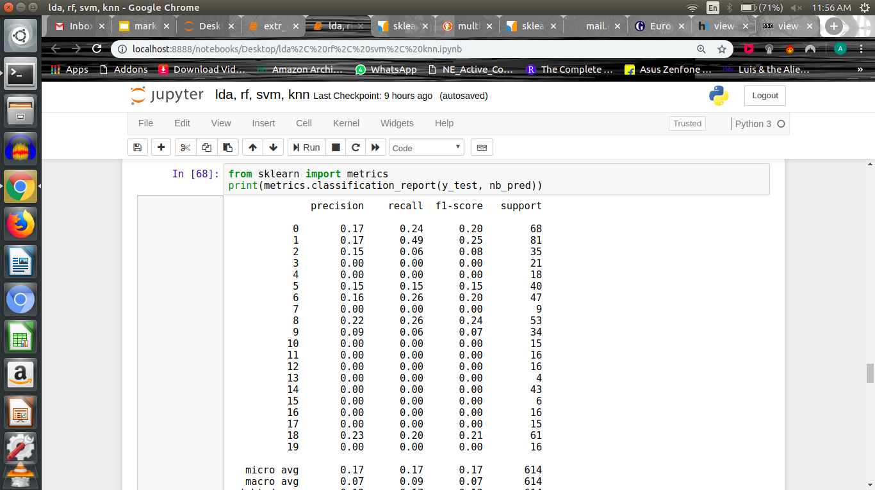
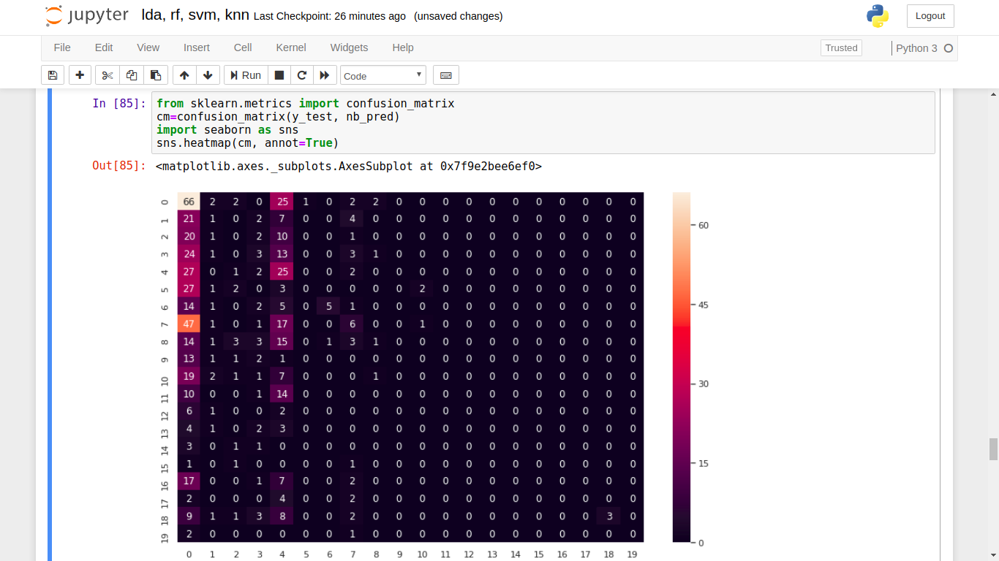
Results
Multinomial NB :-

Slide 30
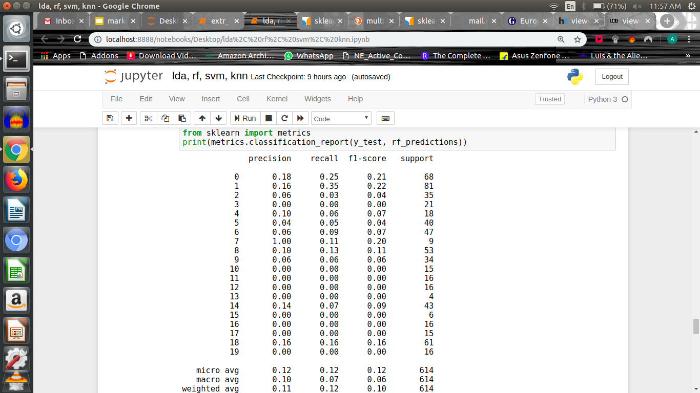
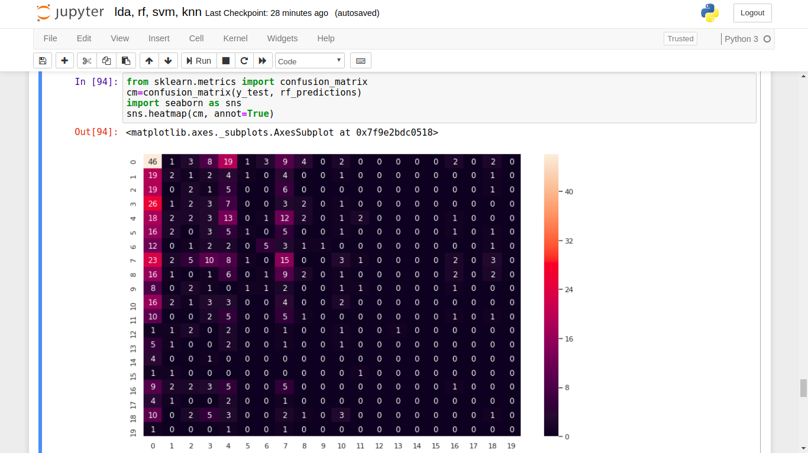
Results(contd.)
Random Forest :-

Slide 31
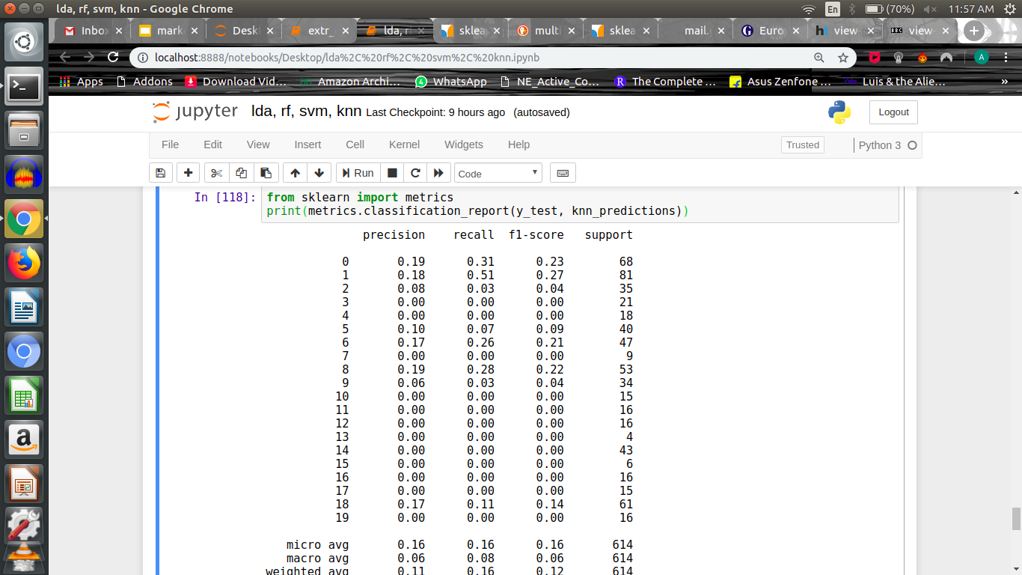
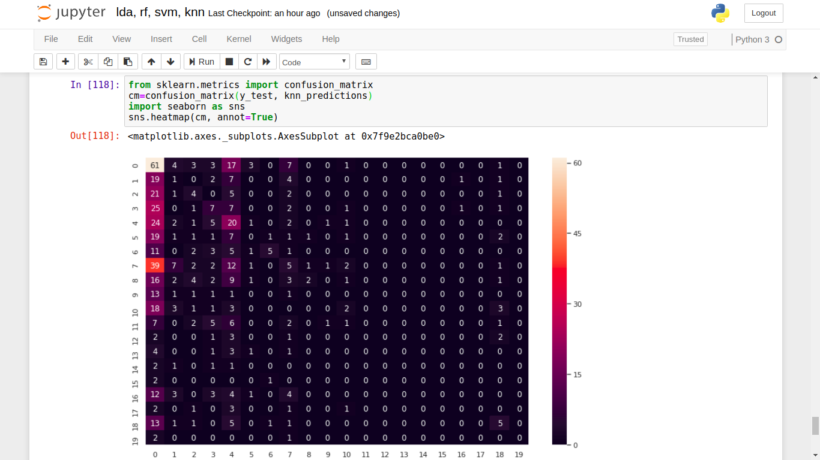
K Nearest Neighbours :-
(k=15)

Slide 32
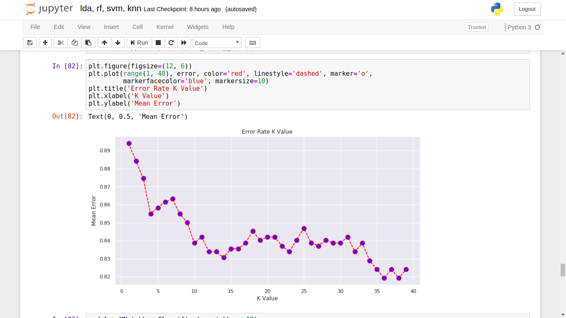
Elbow plot for the selection of k :-

Slide 33
Run time Dilemma
Computing the algorithms ‘run time’ (i.e.,time taken to fit the model):
KNN :is the fastest, taking only 0.184 s to run on a test set of 10,000 articles
Random Forest takes 5.612 and
NN takes 14.668s on the same data.

Slide 34
References :-
Datasets taken from :
https://www.cnet.com/news/
https://www.hindustantimes.com/india-news/
https://radimrehurek.com/gensim/intro.html
https://scikitlearn.org/stable/modules/generated/sklearn.decomposition.LatentDirichletAllocation.html

Slide 35
THANK YOU !!!

